Slide 1
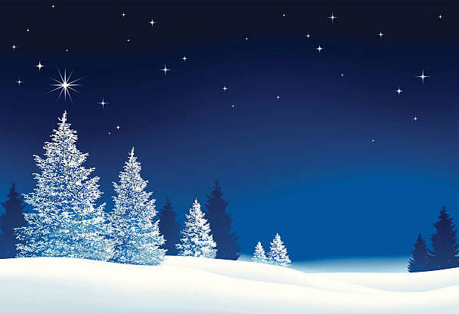
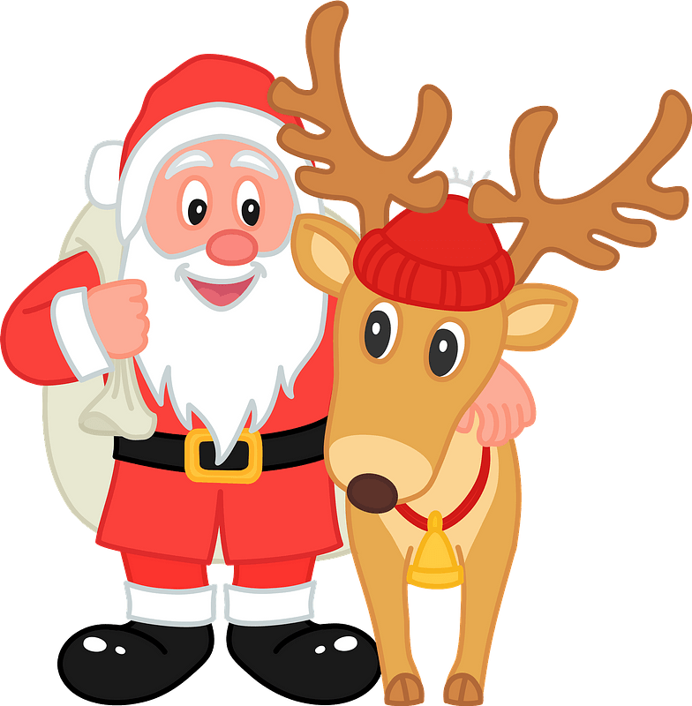
CHRISTMAS GRAMMAR
PLAY

Slide 2

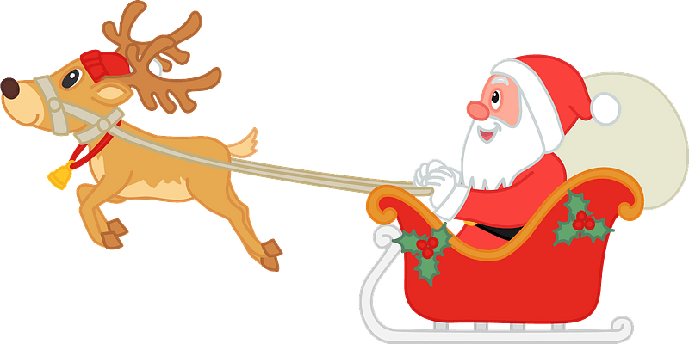
When Santa came, we (sleep)
SANTA
When Santa came, we were sleeping
CHECK

Slide 3
He (climb) through the chimney when he heard a strange noise
SANTA
He was climbing through the chimney when he heard a strange noise
CHECK

Slide 4
The noise (come) from the kitchen
SANTA
The noise was coming from the kitchen
CHECK

Slide 5
Santa opened the kitchen door and saw his reindeer who (eat) our chocolate
SANTA
Santa opened the kitchen door and saw his reindeer who were eating our chocolate
CHECK

Slide 6
The reindeer (munch) loudly
SANTA
The reindeer were munching loudly
CHECK

Slide 7
The chocolate (disappear) quickly
SANTA
The chocolate was disappearing quickly
CHECK

Slide 8
When the reindeer saw Santa, they (finishing) the last bit of chocolate
SANTA
When the reindeer saw Santa, they were finishing the last bits of chocolate
CHECK

Slide 9
When Santa come in, he (frown) sadly
SANTA
When Santa came in his was frowning sadly
CHECK

Slide 10
He put some new chocolate on the table and the reindeer (look) away guiltily
SANTA
He put some new chocolate on the table and the reindeer were looking away guiltily
CHECK

Slide 11
The reindeer (run) quickly, and Santa (sing)
SANTA
The reindeer were running quickly,
and Santa was singing
CHECK

Slide 12
Well done!

