Slide 1
KILLER NOTE: ANIME DIARY INFOGRAPHICS
キラーノート
Here is where your presentation begins

Slide 2
ABOUT KILLER NOTE: ANIME DIARY INFOGRAPHICS
This template contains an assortment of complementary infographic resources for the Killer Note: Anime Diary presentation.
These infographics are adapted to the style of the aforementioned presentation, so you can insert them easily and have them completely integrated at once. You just need to do the following:
  Select the element that you want to copy
  Right-click and choose “Copy”
  Go to the slide where you want the element to appear
  Right-click and choose “Paste”

Slide 3
KILLER NOTE: ANIME DIARY INFOGRAPHICS
07:00 | 08:00 | 09:00 | 10:00
Jupiter is a gas giant and the biggest planet | Mercury is the closest planet to the Sun | Venus has a beautiful name but is hot | Earth is the third planet from the Sun
11:00 | 12:00 | 13:00 | 14:00
Neptune is very far from the Sun | Despite being red, Mars is a cold place | Pluto is considered a dwarf planet | Ceres is located in the main asteroid belt
15:00 | 16:00 | 17:00 | 18:00
Venus is actually terribly hot | Mercury is the smallest planet | Saturn is composed mostly of hydrogen | Earth is the planet that harbors life

Slide 4
KILLER NOTE: ANIME DIARY INFOGRAPHICS
DATE:
START: | 08:00 | FINISH: | 17:00
GOAL: | Despite being red, Mars is actually a cold place
PURCHASE: | Material | CHALLENGE: | Jupiter is a big planet
NOTES:
Jupiter is a gas giant
Mercury is small
Mars is cold
Venus is very hot
Neptune is an ice giant
Mars is a cold place

Slide 5
KILLER NOTE: ANIME DIARY INFOGRAPHICS
DAY PLAN
 | 11:00 | 14:00 | 17:00 | 19:00 | 20:00
JENNA DOE
JOHN JAMES
JIMMY TIMMY

Slide 6
KILLER NOTE: ANIME DIARY INFOGRAPHICS
CANDIDATE CARD
NAME: James
LAST NAME: Don
KNOWN AS: Jamie
DESCRIPTION: Mars is actually a cold place

Slide 7
KILLER NOTE: ANIME DIARY INFOGRAPHICS
DIARY RULES
01
02
03
04
WRITE THE NAME
THINK OF THE FACE
SPECIFY DEATH
HUMAN PROPERTY
Neptune is far from the Sun
Venus is a very hot planet
Jupiter is the biggest planet
Mercury is the smallest planet

Slide 8
KILLER NOTE: ANIME DIARY INFOGRAPHICS
CHECKLIST
I have written the name of the person
I have specified the cause of death
Cause of death is physically possible
I have in mind the face of the person
I have written the causes of death before 19 days
The person in the notebook is not innocent

Slide 9
KILLER NOTE: ANIME DIARY INFOGRAPHICS
NOTEBOOK PEOPLE
NAME: | DESCRIPTION
JENNA DOE | Despite being red, Mars is a cold place
JOHN JAMES | Mercury is the closest planet to the Sun
HELENA JOHN | Earth is the third planet from the Sun
NAME: | DESCRIPTION
DAN JIMMY | Pluto is considered a dwarf planet
SUSAN GARY | Saturn is composed mostly of hydrogen
MATT DON | Ceres is located in the main asteroid belt

Slide 10
KILLER NOTE: ANIME DIARY INFOGRAPHICS
WHERE HAVE THERE BEEN MORE DEATHS?
SATURN
Saturn is composed mostly of hydrogen
JUPITER
Jupiter is a gas giant and the biggest planet

Slide 11
KILLER NOTE: ANIME DIARY INFOGRAPHICS
OTHER RULES
A
If the owner does not write any name for X days, it will die
B
If it is destroyed, all those who have touched the notebook will die
C
A cause of death can only occupy one sheet of paper
D
Diary can be loaned without change of ownership

Slide 12
KILLER NOTE: ANIME DIARY INFOGRAPHICS
Person 1
Person 2
Person 3
Person 4
Person 5
Person 6
Despite being red, Mars is a cold place
ACTION 1
Neptune is the farthest planet to the Sun
ACTION 2
Saturn is composed of hydrogen and helium
ACTION 3
Jupiter is a gas giant and also the biggest planet
ACTION 4

Slide 13
KILLER NOTE: ANIME DIARY INFOGRAPHICS
DESCRIPTION
Saturn is composed mostly of hydrogen
GUILTY?
Jupiter is a gas giant and the biggest planet
INNOCENT?
Despite being red, Mars is a cold place

Slide 14
KILLER NOTE: ANIME DIARY INFOGRAPHICS
IF YOU GIVE UP THE DIARY...
LOSES DIARY MEMORIES
YOU CAN RECOVER IT
Venus is the second planet from the Sun
Mercury is the closest planet to the Sun
PASSES TO ANOTHER PERSON
CAN PUT YOUR NAME
Saturn is composed of hydrogen and helium
Neptune is the farthest planet from the Sun

Slide 15
KILLER NOTE: ANIME DIARY INFOGRAPHICS
HOW MANY DIARY ARE THERE?
DAN’S DIARY
JENNA’S DIARY
JOHN’S DIARY
Jupiter is the biggest planet of them all
Neptune is the farthest planet from the Sun
Venus is the second planet from the Sun
50%
30%
20%

Slide 16
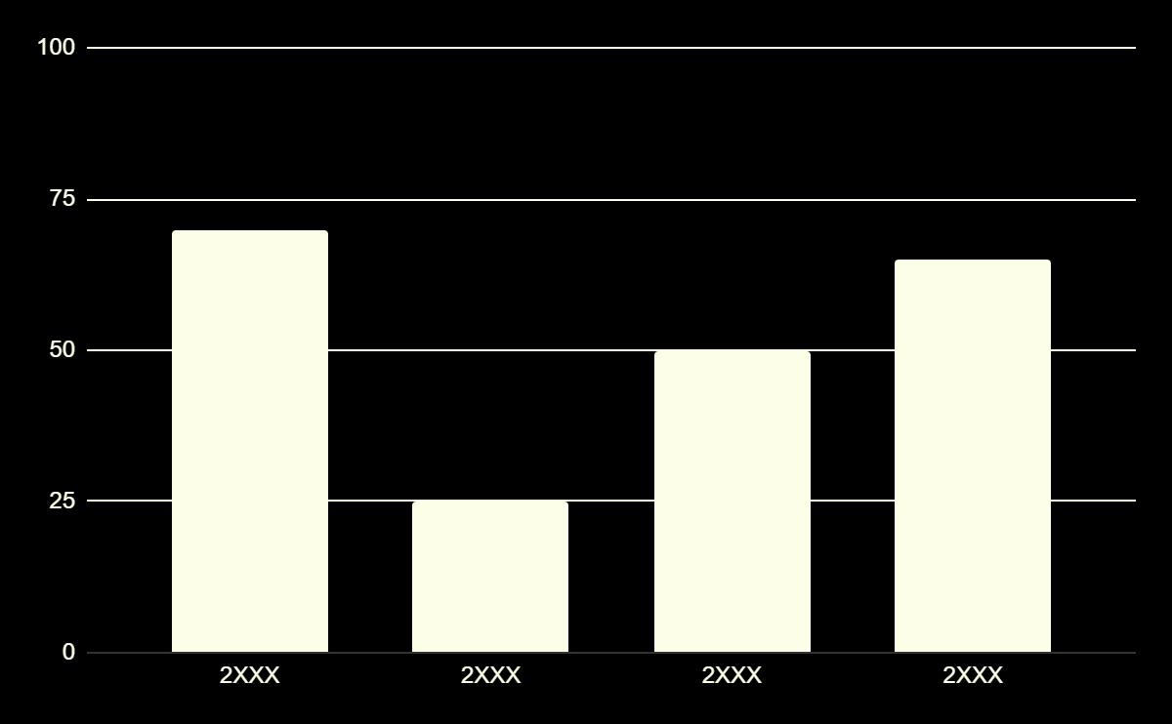
KILLER NOTE: ANIME DIARY INFOGRAPHICS
HOW MANY DEATHS PER YEAR?
70%
25%
VENUS
SATURN
Venus is the second planet from the Sun
Saturn is composed of hydrogen and helium
50%
65%
NEPTUNE
MERCURY
Neptune is the farthest planet from the Sun
Mercury is the closest planet to the Sun
Follow the link in the graph to modify its data and then paste the new one here. For more info, click here

Slide 17
KILLER NOTE: ANIME DIARY INFOGRAPHICS
STEPS TO USE THE DIARY
STEP 1 | THINK FIRST
 | Neptune is the fourth-largest planet by diameter in the Solar System
STEP 2 | LOOK INSIDE
 | Jupiter is a gas giant and the fourth-brightest object in the night sky
STEP 3 | TAKE THE PENCIL
 | Saturn is composed mostly of hydrogen and also helium

Slide 18
KILLER NOTE: ANIME DIARY INFOGRAPHICS
09:00
PERSON 1
10:00
PERSON 2
11:00
PRESON 3
12:00
PERSON 4
13:00
PERSON 5

Slide 19
KILLER NOTE: ANIME DIARY INFOGRAPHICS
WHAT CAN THE DIARY OWNER DO?
USE IT
01
Venus is the second planet from the Sun
TEAR A SHEET
ACTIONS
02
Despite being red, Mars is a cold place
Venus is the second planet from the Sun
LEND IT
03
Mercury is the closest planet to the Sun

Slide 20
KILLER NOTE: ANIME DIARY INFOGRAPHICS
THINK BEFORE WRITING | WRITE YOUR NAME
Mercury is the closest planet to the Sun and the smallest one | Saturn is a gas giant and one of the planets with rings
ALWAYS RESPONSIBLY | MISUSE OF RULES
Jupiter is a gas giant and the biggest planet in the Solar System | Venus has a beautiful name and is the second planet from the Sun

Slide 21
KILLER NOTE: ANIME DIARY INFOGRAPHICS
 | JENNA | JOHN | JAMES | HELENA
DATE | 10.02.23 | 05.04.23 | 16.06.23 | 20.10.23
PLACE | Venus is the second planet from the Sun | Mercury is the closest planet to the Sun | Saturn is a gas giant and has several rings | Neptune is the farthest planet from the Sun

Slide 22
KILLER NOTE: ANIME DIARY INFOGRAPHICS
25%
40%
65%
FEBRUARY
JUNE
OCTOBER
Mercury is the closest planet to the Sun
Jupiter is the biggest planet of them all
Venus is the second planet from the Sun

Slide 23
KILLER NOTE: ANIME DIARY INFOGRAPHICS
PERSONS
 | DATE | PLACE | DESCRIPTION
JENNA | 09/14/23 | Place here | Venus is the second planet from the Sun
JOHN | 10/20/23 | Place here | Neptune is the farthest planet from the Sun
JIMMY | 11/08/23 | Place here | Mercury is the closest planet to the Sun

Slide 24
KILLER NOTE: ANIME DIARY INFOGRAPHICS
RECOMMENDATIONS
THINK
LOOK
WRITE
Venus is the second planet from the Sun
Despite being red, Mars is a cold place
Jupiter is the biggest planet
SPECIFY
RESPONSIBLY
RULES
Mercury is the smallest planet
Neptune is very far from the Sun
Neptune is very far from the Sun

Slide 25
KILLER NOTE: ANIME DIARY INFOGRAPHICS
STEPS FOR THE CORRECT USE
THINK PERSON
WRITE THE NAME
DESCRIBE
Pluto is now considered a dwarf planet
Saturn is composed of hydrogen and helium
Neptune is the farthest planet from the Sun

Slide 26
KILLER NOTE: ANIME DIARY INFOGRAPHICS
DIARY’S DEATH
 | DESCRIPTION | NAME
01 | Mercury is the closest planet to the Sun and the smallest one in the entire Solar System | JENNA
02 | Venus has a very beautiful name but is actually terribly hot, hotter than Mercury | TOMMY
03 | Saturn is a gas giant and has several rings. It's composed mostly of hydrogen and helium | HELENA

Slide 27
KILLER NOTE: ANIME DIARY INFOGRAPHICS
CALENDAR’S DEATH
MO | TU | WE | TH | FR | SA | SU
 |  |  |  |  |  | 1
2 | 3 | 4 | 5 | 6 | 7 | 8
9 | 10 | 11 | 12 | 13 | 14 | 15
16 | 17 | 18 | 19 | 20 | 21 | 22
23 | 24 | 25 | 26 | 27 | 28 | 29
30 | 31
DAY 2
ANNE DOE
Pluto is now considered a dwarf planet
DAY 19
JAMES TIMMY
Venus is the second planet from the Sun

Slide 28
KILLER NOTE: ANIME DIARY INFOGRAPHICS
DEATH’S REASON
NAME | REASON
HELEN | Venus is the second planet from the Sun
JAMIE | Pluto is now considered a dwarf planet
ANNA | Mercury is the closest planet to the Sun
JOHN | Saturn is composed of hydrogen and helium
MARIE | Neptune is very far from the Sun

Slide 29
KILLER NOTE: ANIME DIARY INFOGRAPHICS
MORE RULES
NO EFFECT WHO ARE LESS THAN 780 DAY OLD
Venus is the second planet from the Sun
RIP
TIME AND CAUSE CAN BE CHANGED
Saturn is composed of hydrogen and helium

Slide 30
KILLER NOTE: ANIME DIARY INFOGRAPHICS
PERSON’S DESCRIPTION
JENNA DOE
PROFILE: 35 years old Manhattan Designer Single Venus is the second planet from the Sun
45%
AT HOME
Mercury is the smallest planet
55%
AT WORK
Venus has high temperatures

Slide 31
KILLER NOTE: ANIME DIARY INFOGRAPHICS
DIARY’S ACTIONS
WRITE
LEND IT
DON’T USE IT
Mars is actually a cold place and it’s full of iron oxide dust
Venus is the second planet from the Sun and It’s hot
Saturn is a gas giant and it has rings
Neptune is the farthest planet from the Sun
Mercury is the smallest planet in the Solar System
Jupiter is a gas giant and the biggest planet in the Solar System

Slide 32
Instructions for use (premium users)
As a Premium user, you can use this template without attributing Slidesgo.
You are allowed to:
Modify this template.
Use it for both personal and commercial purposes.
Hide or delete the “Thanks” slide and the mention to Slidesgo in the credits.
Share this template in an editable format with people who are not part of your team.
You are not allowed to:
Sublicense, sell or rent this Slidesgo Template (or a modified version of this Slidesgo Template).
Distribute this Slidesgo Template (or a modified version of this Slidesgo Template) or include it in a database or in any other product or service that offers downloadable images, icons or presentations that may be subject to distribution or resale.
Use any of the elements that are part of this Slidesgo Template in an isolated and separated way from this Template.
Register any of the elements that are part of this template as a trademark or logo, or register it as a work in an intellectual property registry or similar.
For more information about editing slides, please read our FAQs or visit our blog:
https://slidesgo.com/faqs and https://slidesgo.com/slidesgo-school

Slide 33
Infographics
You can add and edit some infographics to your presentation to present your data in a visual way.
Choose your favourite infographic and insert it in your presentation using Ctrl C + Ctrl V or Cmd C + Cmd V in Mac.
Select one of the parts and ungroup it by right-clicking and choosing “Ungroup”.
Change the color by clicking on the paint bucket.
Then resize the element by clicking and dragging one of the square-shaped points of its bounding box (the cursor should look like a double-headed arrow). Remember to hold Shift while dragging to keep the proportions.
Group the elements again by selecting them, right-clicking and choosing “Group”.
Repeat the steps above with the other parts and when you’re done editing, copy the end result and paste it into your presentation.
Remember to choose the “Keep source formatting” option so that it keeps the design. For more info, please visit our blog.

