Slide 1
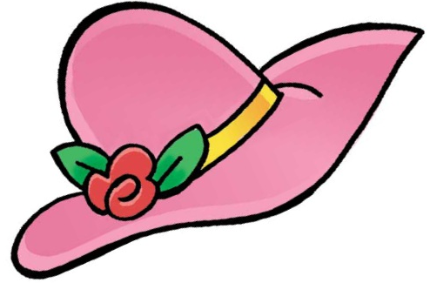
IS IT A HAT?
YES, IT IS.
NO, IT ISN’T.
click here to download more https://t.me/EnglishZonePowerPoints
YES, IT IS.

Slide 2
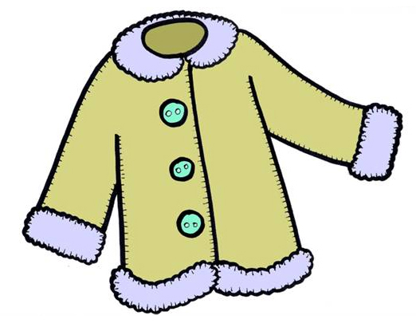
IS IT A HAT?
YES, IT IS.
NO, IT ISN’T.
NO, IT ISN’T.

Slide 3
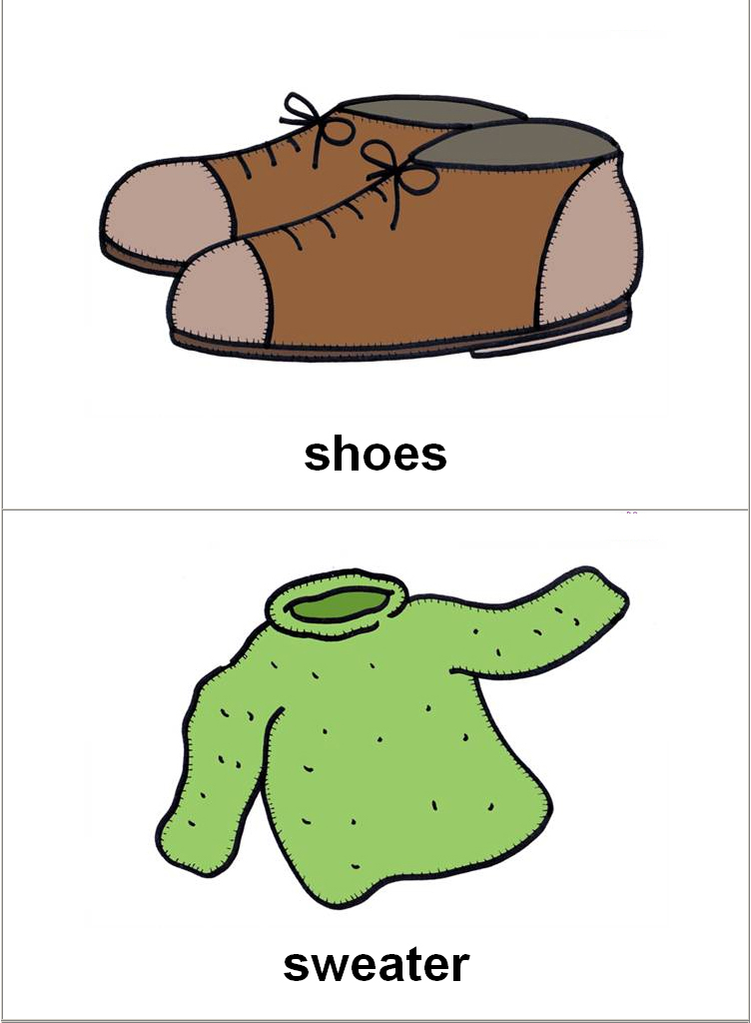
IS IT A JUMPER?
YES, IT IS.
NO, IT ISN’T.
YES, IT IS.

Slide 4
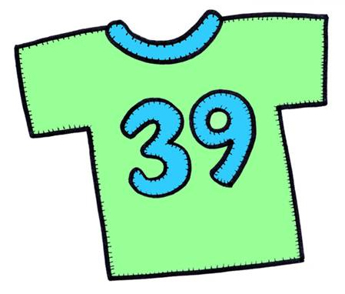
IS IT A JUMPER?
YES, IT IS.
NO, IT ISN’T.
NO, IT ISN’T.

Slide 5
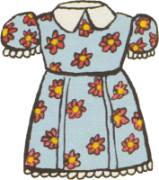
IS IT A DRESS?
YES, IT IS.
NO, IT ISN’T.
YES, IT IS.

Slide 6
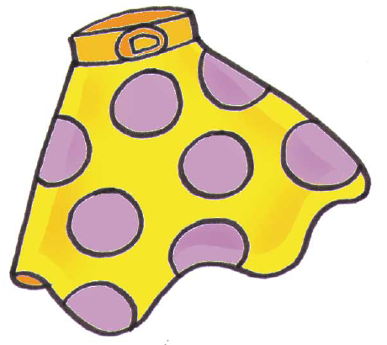
IS IT A DRESS?
YES, IT IS.
NO, IT ISN’T.
NO, IT ISN’T.

Slide 7
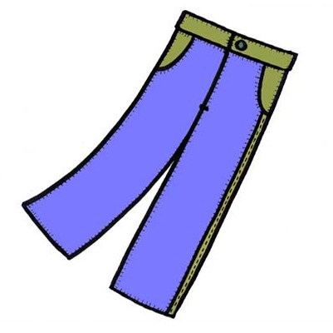
ARE THEY TROUSERS?
YES, THEY ARE.
NO, THEY AREN’T.
YES, THEY ARE.

Slide 8
ARE THEY TROUSERS?
YES, THEY ARE.
NO, THEY AREN’T.
NO, THEY AREN’T.

Slide 9
IS IT A COAT?
YES, IT IS.
NO, IT ISN’T.
YES, IT IS.

Slide 10
IS IT A T-SHIRT?
YES, IT IS.
NO, IT ISN’T.
click here to download more https://t.me/EnglishZonePowerPoints
NO, IT ISN’T.

Slide 11
IS IT A T-SHIRT?
YES, IT IS.
NO, IT ISN’T.
YES, IT IS.

Slide 12
IS IT A SKIRT?
YES, IT IS.
NO, IT ISN’T.
NO, IT ISN’T.

Slide 13
IS IT A SKIRT?
YES, IT IS.
NO, IT ISN’T.
YES, IT IS.

Slide 14
IS IT A HAT?
YES, IT IS.
NO, IT ISN’T.
NO, IT ISN’T.

Slide 15
ARE THEY SHOES?
YES, THEY ARE.
NO, THEY AREN’T.
YES, THEY ARE.

